Slide 1
Web Technology

Slide 2
AGENDA
JSON
API
Web Service
Rest
Restful API
LAB

Slide 3


Slide 4
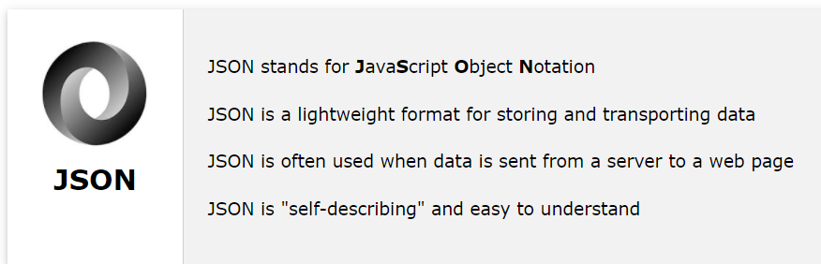
What is JSON?

Slide 5
JSON supports mainly 6 data types
String
Number
Boolean
Null
Object
Array

Slide 6
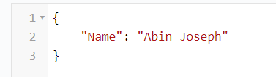



JSON Example
STRING
NUMBER
NULL
BOOLEAN

Slide 7
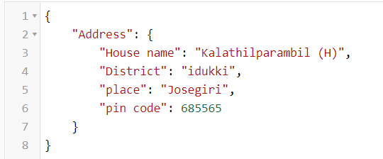
JSON Example
ARRAY
OBJECT

Slide 8
Use Case
{
"Name": "Abin Joseph",
"age": 21,
"Address": {
"House": "Kalathilparambil (H)",
"District": "idukki",
"place": "Josegiri",
"code": 685565
},
"Technology": [
"ReactJS",
"NextJS",
"Angulaer12",
"Firebase",
"NodeJS",
"ExpressJS",
"serverless"
],
"Data": null
}

Slide 9
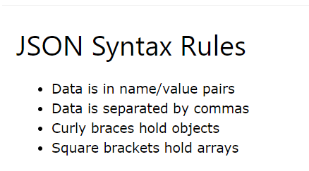
JSON Syntax Rules

Slide 10
JSON VS XML
{
"Name": "Abin Joseph",
"age": 21,
"Address": {
"House name": "Kalathilparambil (H)",
"District": "idukki",
"place": "Josegiri",
"pin code": 685565
},
"Technology": ["ReactJS", "NextJS", "Angulaer12", "Firebase", "NodeJS", "ExpressJS", "serverless", "etc.."],
"Data": null
}
<?xml version="1.0" encoding="UTF-8" ?>
<root>
<Name>Abin Joseph</Name>
<age>21</age>
<Address>
<District>idukki</District>
<place>Josegiri</place>
<House_name>Kalathilparambil (H)</House_name>
<pin_code>685565</pin_code>
</Address>
<Technology>ReactJS</Technology>
<Technology>NextJS</Technology>
<Technology>Angulaer12</Technology>
<Technology>Firebase</Technology>
<Technology>NodeJS</Technology>
<Technology>ExpressJS</Technology>
<Technology>serverless</Technology>
<Technology>etc..</Technology>
<Data/>
</root>

Slide 11
JSON VS XML
<?xml version="1.0" encoding="UTF-8" ?>
<root>
<employees>
<firstName>John</firstName>
<lastName>Doe</lastName>
</employees>
<employees>
<firstName>Anna</firstName>
<lastName>Smith</lastName>
</employees>
<employees>
<firstName>Peter</firstName>
<lastName>Jones</lastName>
</employees>
</root>
{
"employees":[
{"firstName":"John", "lastName":"Doe"},
{"firstName":"Anna", "lastName":"Smith"},
{"firstName":"Peter", "lastName":"Jones"}
]
}

Slide 12
Web Services

Slide 13
What is an Web Services ?

Slide 14
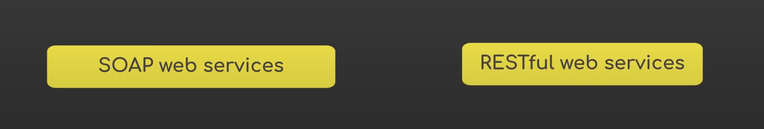
Web Services

Slide 15
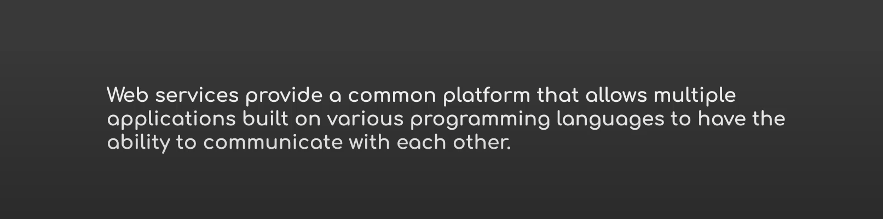
Web Services

Slide 16
Web Services
Web Services
A web service is a software system designed to support interoperable machine-to​-machine interaction over a network

Slide 17







Web Services

Slide 18
API

Slide 19
What is an API ?
Application Programming Interface

Slide 20
What is an API ?
API is the acronym for Application Programming Interface, which is a software intermediary that allows two applications to talk to each other. Each time you use an app like Facebook, send an instant message, or check the weather on your phone, you’re using an API.

Slide 21
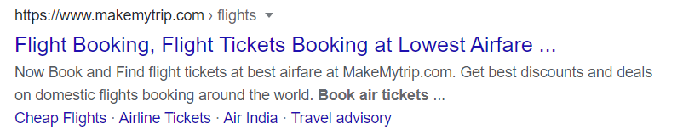
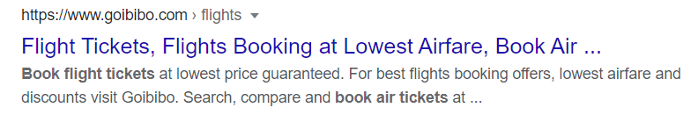
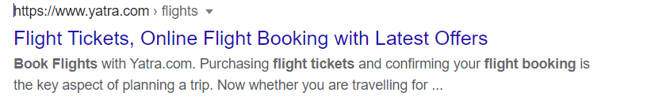
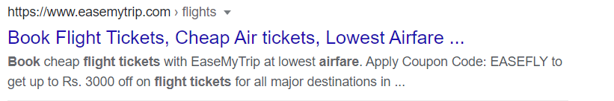
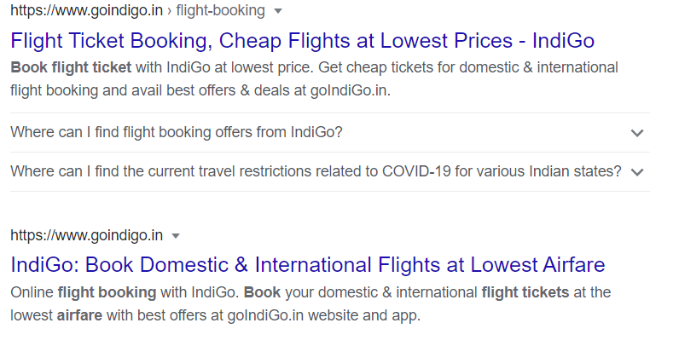
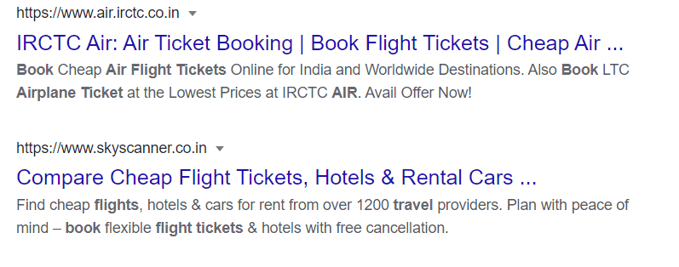
Book Plane Ticket

Slide 22

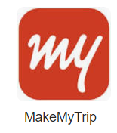
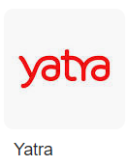
Plane Ticket
API

Slide 23
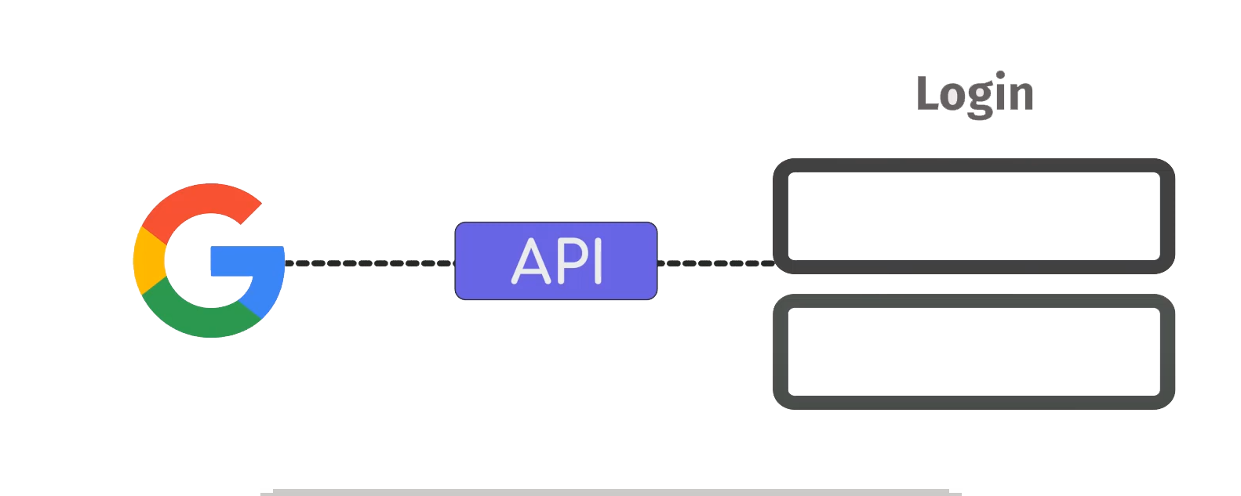
API

Slide 24
REST

Slide 25
What is an REST ?
What is an REST ?
Representational State Transfer

Slide 26
What is an REST ?
Representational state transfer is a software architectural style that was created to guide the design and development of the architecture for the World Wide Web. REST defines a set of constraints for how the architecture of an Internet-scale distributed hypermedia system, such as the Web, should behave

Slide 27
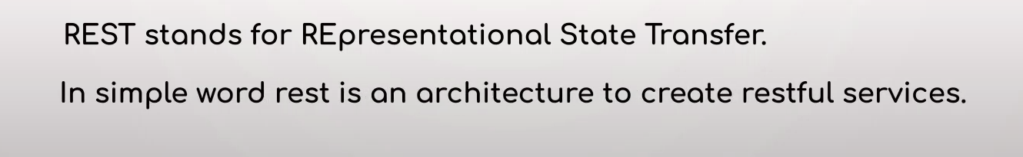
REST

Slide 28
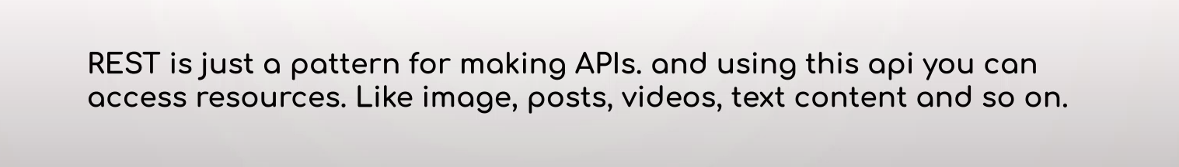
REST

Slide 29
What is an RESTFUL API ?

Slide 30
What is an RESTFUL API ?

Slide 31
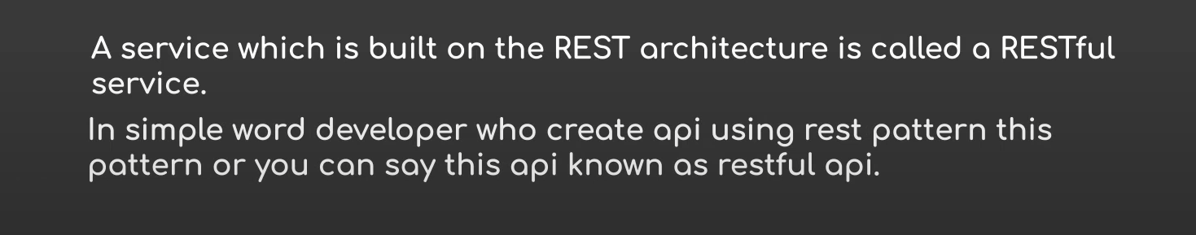
Restful API

Slide 32
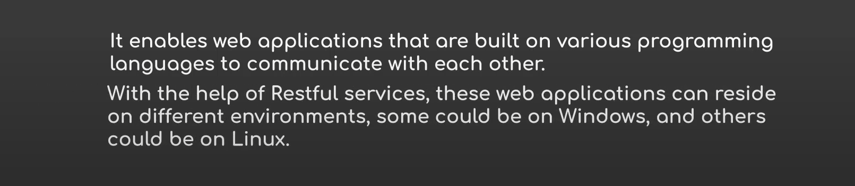
Why Restful API

Slide 33
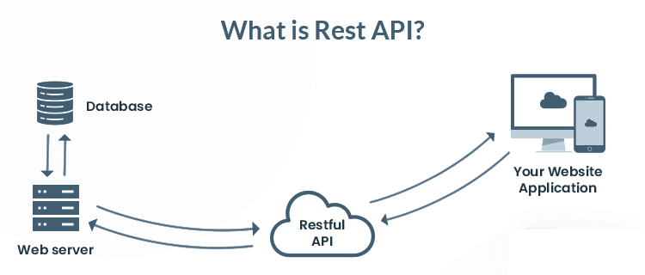

Slide 34
CRUD Operations

Slide 35
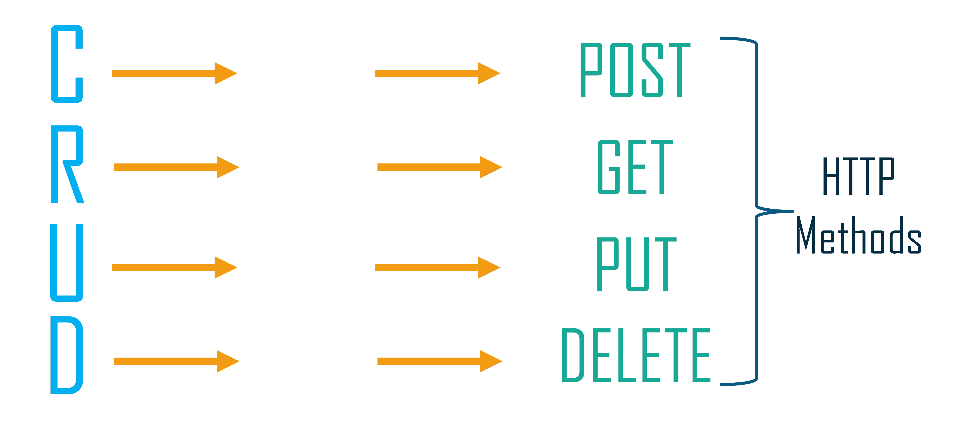
Create
Read
Update
Delete

Slide 36
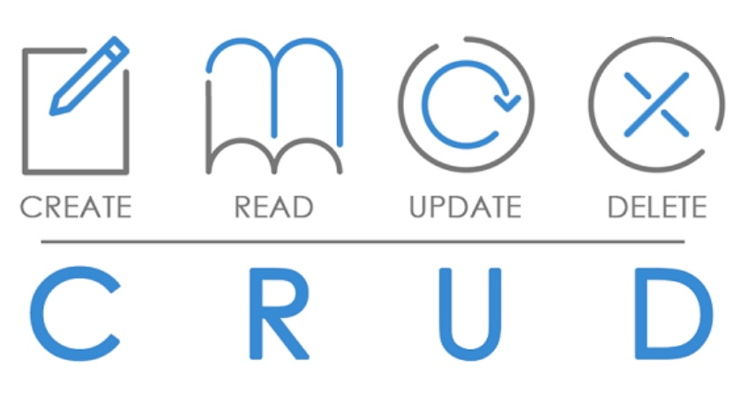

Slide 37

REST

Slide 38
Any Doubts

Slide 39
Links
https://jsonlint.com/
https://www.w3schools.com/whatis/whatis_json.asp/
https://www.convertjson.com/json-to-xml.htm/
https://dog.ceo/api/breeds/image/random

Slide 40
We can see some practical examples

Slide 41
So that's it

Slide 42
Thank You All

